Slide 1
Generative Adversarial Networks
Sunghyun Myung
shm@kaist.ac.kr
Original slides credit: Whie Jung
whieya@kaist.ac.kr

Slide 2
Table of Contents
Environment Setup (Already done in Lab part 1)
Google Colaboratory
PyTorch (Already prepared in Colab)
Lab-1 : GANs for image generation
Lab 1-a : Unconditional GANs with MNIST dataset
Lab 1-b : Conditional GANs (Auxiliary Classifier GANs) with MNIST dataset
Lab-2 : GANs for image-to-image translation
Lab 2 : Pix2Pix model for colorization task

Slide 3

Environment Setup
Colab
Provide Cloud-based Jupyter Notebook Environment.
Free! Easy!
PyTorch
Project codes
https://bit.ly/3zkBPBZ
Make a copy in your Google drive.

Slide 4
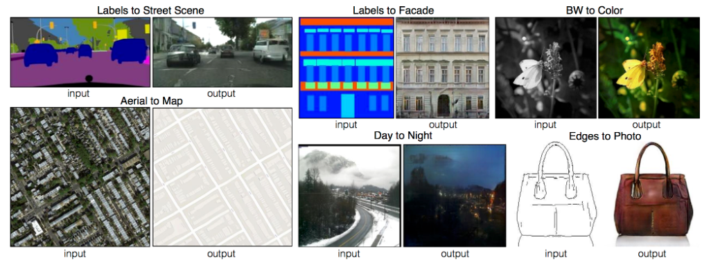
Lab 2 : Pix2Pix
Goal
Implement Pix2Pix model for image-to-image translation task.
Dataset : Facade database
Target task : semantic figures -> RGB facade images

Slide 5
Lab 2 : Pix2Pix
Goal
Implement Pix2Pix model for image-to-image translation task.
Dataset : Facade database
Target task : semantic figures -> RGB facade images
Flow
Prepare Facade dataloader
Define GAN model(Generator & Discriminator)
Generator : Unet / Discriminator : PatchGAN
Train GAN
In addition to adversarial objective, force L1 loss to accurately reconstruct original image.

Slide 6

Lab 2 : Pix2Pix
Recap of GAN framework
Noise
G
Fake Image
Real? Fake?
D
Real Image
GAN’s adversarial objective

Slide 7

Lab 2 : Pix2Pix
Pix2Pix (image-to-image translation) framework
Similar to AC-GAN, just without latent z and classification layer.
Input Image
G
Fake Image
Real? Fake?
D
Real Image
Adversarial objective

Slide 8
Lab 2 : Pix2Pix
Pix2Pix (image-to-image translation) framework
Similar to AC-GAN, just without latent z and classification layer.
Input Image
G
Fake Image
Real? Fake?
D
Real Image
Reconstruction loss
L1 loss between (Fake image, Real image)
Generator should construct images that are realistic and close to real (training data) image.

Slide 9
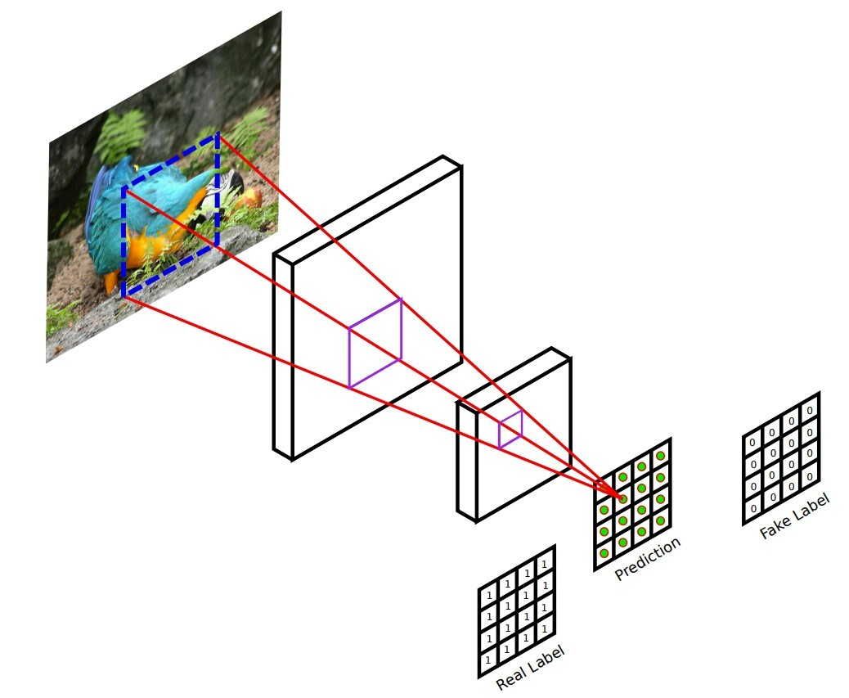
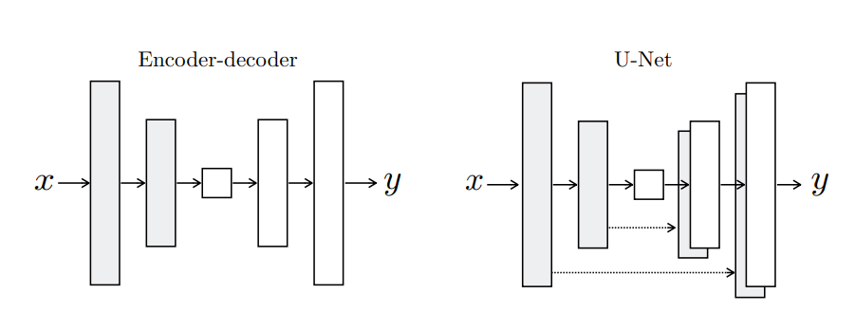
Lab 2 : Pix2Pix
Discriminator: PatchGAN
Two inputs
Image output from generator
Expected output from training data
Output
Single channel prediction map
Generator: UNet
Input is an image; here we don’t sample from latent. Therefore, the model is deterministic.
Output is also an image of the same size.
Both modules are already implemented; you will use them by invoking the forward pass!

Slide 10
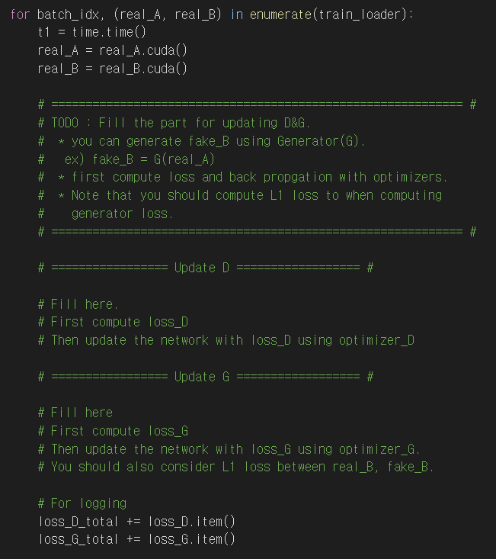
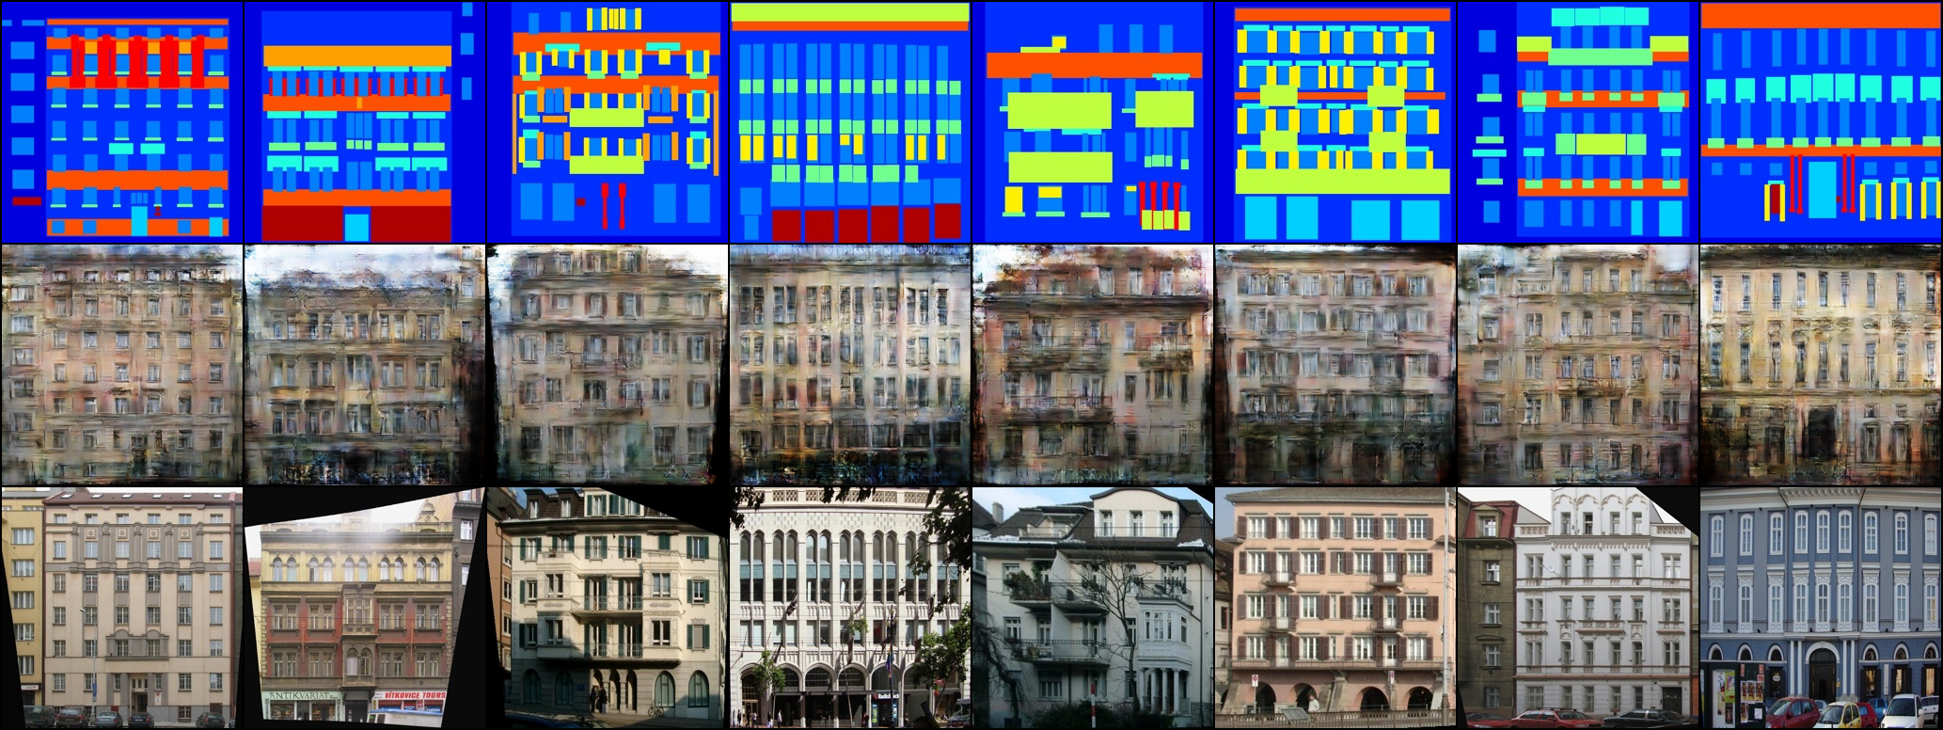
Lab 2 : Pix2Pix
Training Pix2pix
We want to learn real_A -> real_B
real_A
fake_B
real_B (GT)

Slide 11
Lab 2 : Pix2Pix
Discriminator
Usage D(torch_cat(A, B), dim=1))
Obtain fake_B from Generator
Create real(1) / fake(0) labels
torch.ones_like(), torch.zeros_like()
Binary cross entropy on real/fake images
BCE_criterion()
Update loss_D using optimizer_D
Generator
Create real (1) label
torch.ones_like()
Binary cross entropy
BCE_criterion()
We add L1 loss on the generated image to guide image generation.
loss = |fake_B - real_B|
nn.L1loss()
Obtain loss_G = (BCE loss) + LAMBDA_L1 * (L1 loss)
Update loss_G using optimizer_G
real_A
fake_B
real_B (GT)

Slide 12
Lab 2 : Pix2Pix
Expected Results
Given
Generated
GT

Slide 13
Complete Code
If you need complete code, contact me at shm@kaist.ac.kr

Slide 14
Thank You

